Slide 1
USDA FSA Prototype Design
Version 5
8/21/2018
Includes: Workflow description; Personas; Mockups

Slide 2
Workflow (as of 8/22)
User first sees the Discuss page, where some comments from mock users have already been made, to illustrate how this page can be used to ask for and gain insight as a community of users who are learning and advancing their knowledge
User can choose to see topics that are of interest to them, and even follow a topic to be informed of when new posts have been made
User can add to the discussion by posting a new comment in the box provided at the bottom and can choose to follow a discussion thread
User can create new analytics and visualizations on the Analyze page
User can choose one or more datasets to analyze in Step 1, then proceed to Step 2
User can look through analytical categories (insights) and choose one or more analytics that would help them achieve their analysis/visualization goal, then proceed to Step 3
User receives tabs, one for each type of analytic they chose in Step 2, where they can choose what variables they want to the visualization to consider
User can then run the analytics and receive a visualization
As an alternative to analyzing datasets individually, 2 datasets can be merged to provide even more understanding of trends and make predictions across datasets; to do this the user selects 2 datasets, clicks the merge button, and chooses what variables from each dataset they want to perform analytics on, then progresses through Step 2 and 3 as above
User can choose to post their work to the Discuss page along with a caption and their insights to help the community

Slide 3
Personas (as of 8/22) (1 of 3)
Persona | USDA/Agency Executive Level User
Fictional Name | John Vision
Job title/major responsibilities | Agency CIO Strategic information consumer responsible for understanding and improving the experience and capabilities of USDA (and related sites) for customers.
Experience and Expectations | USDA or agency head. Technically savvy. Very familiar with the technology, support, and application USDA data and services within their scope of authority. Expects a highly intuitive, easy to use solution for self-serving quick-hit information needs.
Goals | Understand how customers feel about USDA data and services, if they are satisfied, to gauge how well USDA, Agencies and Mission Areas are doing – Voice of the Customer insights. Understand historically USDA data and services to continue providing current level of support. Understand near-term customer needs and how they might translate to new or improved services. Predict long-term customer needs. Understand how customer needs are changing. Ability to analyze new feedback, perhaps in a new type of survey, to serve the aforementioned goals.

Slide 4
Personas (as of 8/22) (2 of 3)
Persona | USDA/Agency Management Level User
Fictional Name | Jane Pathforger
Job title/major responsibilities | Department Chief Strategic and tactical information consumer. Agency mission area responsibilities include maintaining keen insight on the current, historical and potential future performance and needs of their organization, and the upstream and downstream needs of inter-agency partners, with emphasis on understanding and improving the experience and capabilities of USDA (and related sites) supporting customers.
Experience and Expectations | USDA employee. Power user. Has specific recurring reporting needs. Needs the latest and greatest data. May not be an expert in statistical analysis, but is fairly familiar with datasets, how to use them in novel ways, interpreting complex graphs, and using websites. May care less about mobile capability as the full capabilities of the application are needed most often.
Goals | Quick access to saved work for reuse and repurposing. Quickly seeing and understanding changes in data. Be able to answer new and challenging questions within and across datasets. Complex search, analysis, and visualizations. Tweak and tailor visualizations. Make near-term and far-ranging decisions using analytics and visualizations. See, comment, and share visualizations to help the user community’s interaction and understanding grow.

Slide 5
Personas (as of 8/22) (3 of 3)
Persona | USDA/Agency Individual Contributor
Fictional Name | Tracy Taskmaster
Job title/major responsibilities | Business Data Analyst Strategic, tactical and operational information provider. Responds to upper management requests for information on a wide range of unpredictable topics/scenarios with very short turn-around. Required to be aware of current and new data sets and their potential value to the management chain they support.
Experience and Expectations | USDA/Agency associate (employee or contractor) Power user with strong statistical analysis skills. Highly familiar with available data sets. Relies on current, trusted data.
Goals | Satisfy simple information requests within 4 hours, medium complexity requests within 8 hours, complex requests within 24 hours. Quick access to saved work for reuse and repurposing. Quickly seeing and understanding changes in data. Be able to answer new and challenging questions within and across datasets. Complex search, analysis, and visualizations. Tweak and tailor visualizations based on evolving management needs. See, comment, and share visualizations to help the user community’s interaction and understanding grow.

Slide 6


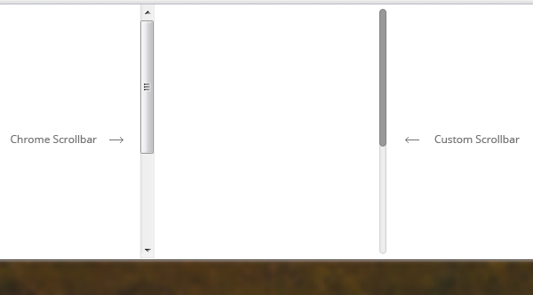
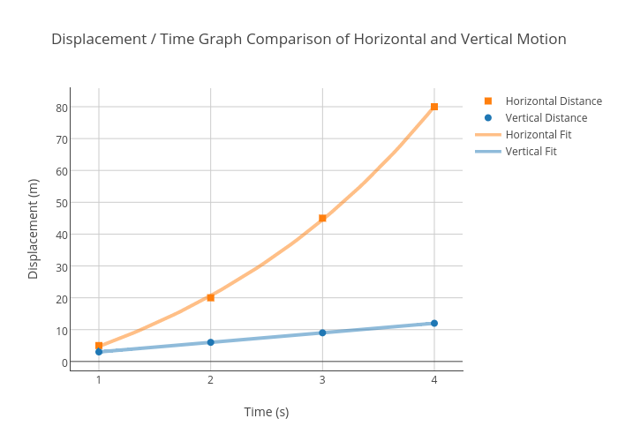


Data Analysis...
May want to use these in multiple places so we can inform the prototype users what is disabled (doesn’t work or requires a specific action)
https://www.usda.dataanalystis.gov
LOGIN
MY PROFILE
CONTACT US
Graph
Comparison Table
CONTACT US
COMMUNITY STORIES | NEW VISUALIZATION | MY VISUALIZATIONS
?
Join the discussion!
Newest
Look and feel more like Slack, to promote the ‘discussion’ aspect of this page
Corn production outpaces demand recently
Contains topics from USDA, but all are disabled
Topic: Agriculture
Joe Smith on August 8, 2018
Comment on this card to get a new card; prototype likely cannot support spin-off threads, cards will be added sequentially in a vertical list
I know that the uses of corn have only been expanding, so it makes sense that cultivation has grown too, but the actual demand for...

Slide 7
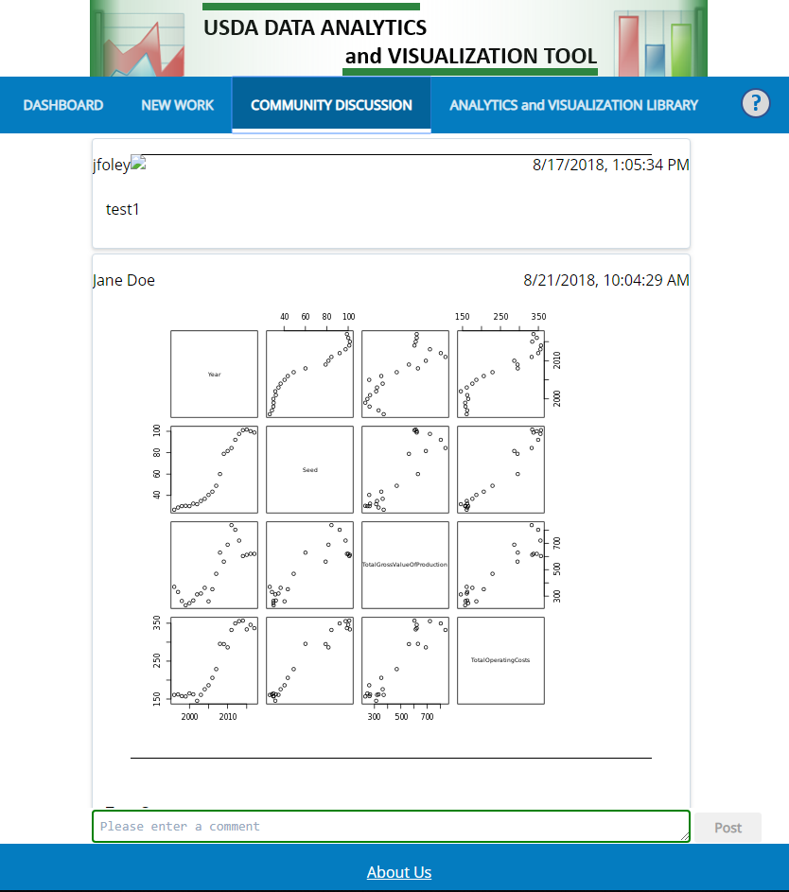
Join the discussion!
Choose a topic to view:
Newest
Follow
Follow
Can hang out here like the ‘post’ button, or if easier to develop, put inside the card, preferably at the top middle
Looked at ‘follow’, ‘like’ and ‘subscribe’ icons choices but wanted it absolutely clear in the prototype what this was, so went with a worded button

Slide 8
Join the discussion!
Choose a topic to view:
Newest
Follow
If the topic follow button is clicked...
Follow this topic
x
X
Alert me when someone posts to this topic
Generate Visualization
Follow
Ok
Cancel
Size here is arbitrary, development can reduce this to use less space/conform to the size of other dialogs

Slide 9
Join the discussion!
Choose a topic to view:
Newest
Follow
Follow this topic
x
X
Alert me when someone comments on this post
Generate Visualization
Follow
X
Add usernames separated by a semicolon for those that you would like to also be alerted
If the comment follow button is clicked...
Ok
Cancel

Slide 10


Data Analysis...
https://www.usda.dataanalystis.gov
LOGIN
MY PROFILE
CONTACT US
Graph
Comparison Table
CONTACT US
COMMUNITY STORIES | NEW VISUALIZATION | MY VISUALIZATIONS
?
1. Choose your data
3. Choose your variables and visualize results
0 of n datasets selected
Supported | Merged | To be supported
These could look more like tabs, since we use them in Step 3, but thought this look and feel might be cleaner
Search datasets....
Name Mergable? Details
Data set name Yes
Description here can wrap
up to 2 lines
View
Data set name Yes
Description here can wrap
up to 2 lines
View
Search within dataset tabs, rather than across them. In the future, we wouldn’t have a ‘To be supported’ list, but right now it should be a dumping ground of all the datasets we know we’ll need to support in the future, but cannot in the prototype
Data set name Yes
Description here can wrap
up to 2 lines
View
Data set name Yes
Description here can wrap
up to 2 lines
View
Import
Merge Selected
Next step
2. Choose your insight
Import dialog not designed yet, confirm we want to develop this to imply users might do this in the future
Next step

Slide 11
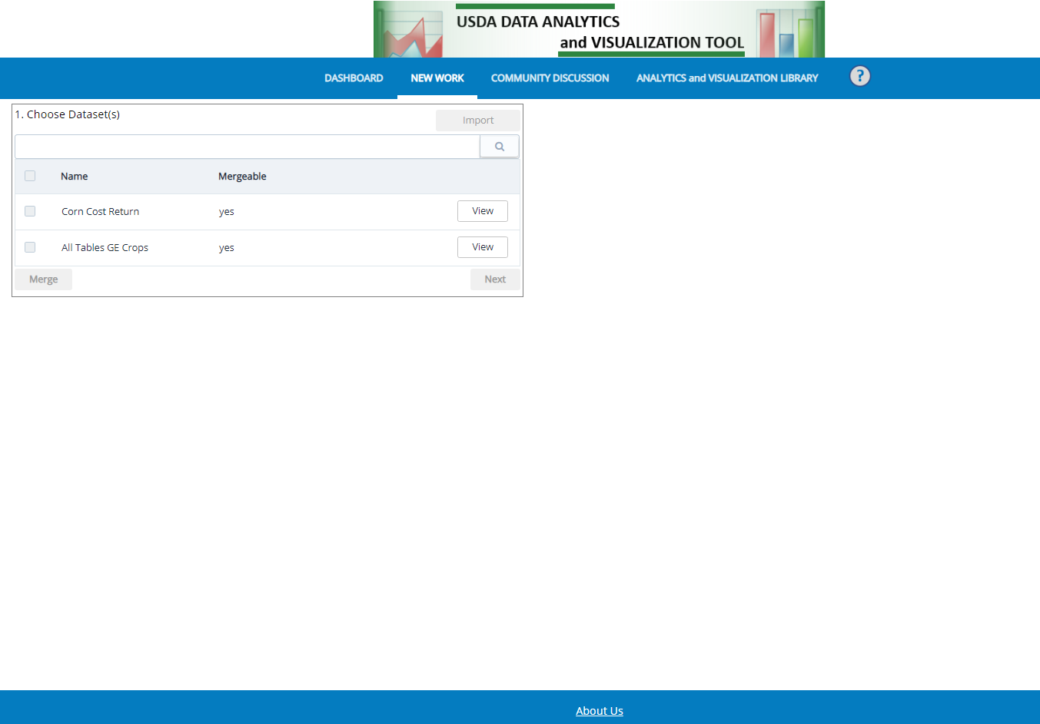
Follow
Follow
If the dataset follow button is clicked...
Follow this dataset
x
X
Alert me when this dataset changed
Ok
Generate Visualization
Cancel

Slide 12
Data Analysis...
https://www.usda.dataanalystis.gov
LOGIN
MY PROFILE
CONTACT US
Graph
Comparison Table
CONTACT US
COMMUNITY STORIES | NEW VISUALIZATION | MY VISUALIZATIONS
?
1. Choose your data
3. Choose your variables and visualize results
2 of n datasets selected
Supported | Merged | To be supported
Search datasets....
Name Mergable? Details
X
Data set name Yes
Description here can wrap
up to 2 lines
View
X
Data set name Yes
Description here can wrap
up to 2 lines
View
Data set name Yes
Description here can wrap
up to 2 lines
View
Data set name Yes
Description here can wrap
up to 2 lines
View
Import
Merge Selected
Next step
2. Choose your insight
Next step

Slide 13
Data Analysis...
https://www.usda.dataanalystis.gov
LOGIN
MY PROFILE
CONTACT US
Graph
Comparison Table
CONTACT US
COMMUNITY STORIES | NEW VISUALIZATION | MY VISUALIZATIONS
?
1. Choose your data
3. Choose your variables and visualize results
2 of n datasets selected
Supported | Merged | To be supported
Search datasets....
Name Mergable? Details
Data set name Yes
Description here can wrap
up to 2 lines
Reuse the developed merge dialog we already have in place of this box
Ensure these are fields for users to fill out in this dialog:
Name new dataset; write a description
(enhancement) add choices:
Continue with this data set (upon click of this button, dialog closes, prototype unchecks previously selected datasets, the ‘merged’ list of datasets comes into focus, the merged dataset is checked)
Go back and merge another (upon click of this button, dialog closes, user is simply shown the last state of the prototype with the 2 datasets selected and the ‘supported’ list in focus)
X
View
X
Data set name Yes
Description here can wrap
up to 2 lines
View
Data set name Yes
Description here can wrap
up to 2 lines
View
Data set name Yes
Description here can wrap
up to 2 lines
View
Import
Merge Selected
Next step
2. Choose your insight
Next step

Slide 14
Data Analysis...
https://www.usda.dataanalystis.gov
LOGIN
MY PROFILE
CONTACT US
Graph
Comparison Table
CONTACT US
COMMUNITY STORIES | NEW VISUALIZATION | MY VISUALIZATIONS
?
1. Choose your data
3. Choose your variables and visualize results
1 of n datasets selected
Supported | Merged | To be supported
Search datasets....
Name Data set sources
X
Merged data set name Dataset name 1;
Description here can wrap Dataset name
up to 2 lines
Import
Merge Selected
Next step
2. Choose your insight
Next step

Slide 15
Data Analysis...
https://www.usda.dataanalystis.gov
LOGIN
MY PROFILE
CONTACT US
Graph
Comparison Table
CONTACT US
COMMUNITY STORIES | NEW VISUALIZATION | MY VISUALIZATIONS
?
1. Choose your data
3. Choose your variables and visualize results
1 of n datasets selected
Supported | Merged | To be supported
Search datasets....
Name Data set sources
X
Merged data set name Dataset name 1;
Description here can wrap Dataset name
up to 2 lines
Import
Merge Selected
Next step
Needs further discussion, is this a relevant use-case that should have front-end support, or would be done by experts/analysts? Could see this function being misunderstood or a misused
2. Choose your insight
0 of n insights selected
+
I want to see the data organized
+
I want to see trends in the data
+
I want to see predictions
+
I need a new type of insight
Next step

Slide 16
Data Analysis...
https://www.usda.dataanalystis.gov
LOGIN
MY PROFILE
CONTACT US
Graph
Comparison Table
CONTACT US
COMMUNITY STORIES | NEW VISUALIZATION | MY VISUALIZATIONS
?
1. Choose your data
3. Choose your variables and visualize results
1 of n datasets selected
Supported | Merged | To be supported
Search datasets....
Name Data set sources
X
Merged data set name Dataset name 1;
Description here can wrap Dataset name
up to 2 lines
Import
Merge Selected
Next step
2. Choose your insight
2 of n insights selected
-
I want to see the data organized
Comparison tables
Box plots
Scatter plots
Pie charts
Learn more
Learn more
Learn more
Learn more
May not need a vertical scrollbar, but put it in here to support the restriction within PPT of fitting this all on one slide
X
-
I want to see trends in the data
X
Trend lines
Correlation heat maps
Learn more
Learn more
Next step

Slide 17
Data Analysis...
https://www.usda.dataanalystis.gov
LOGIN
MY PROFILE
CONTACT US
Graph
Comparison Table
CONTACT US
COMMUNITY STORIES | NEW VISUALIZATION | MY VISUALIZATIONS
?
1. Choose your data
3. Choose your variables and visualize results
1 of n datasets selected
Supported | Merged | To be supported
Scatter plots
Trend lines
Search datasets....
Variables to display
Name Data set sources
X Axis
Variable 1
Y Axis
Variable 4
Variable 6
Variable 10
X
Merged data set name Dataset name 1;
Description here can wrap Dataset name
up to 2 lines
Generate Visualization
Import
Merge Selected
Next step
2. Choose your insight
2 of n insights selected
-
I want to see the data organized
Comparison tables
Box plots
Scatter plots
Pie charts
Learn more
Learn more
Learn more
Learn more
X
-
I want to see trends in the data
X
Trend lines
Correlation heat maps
Learn more
Learn more
Next step
Post

Slide 18
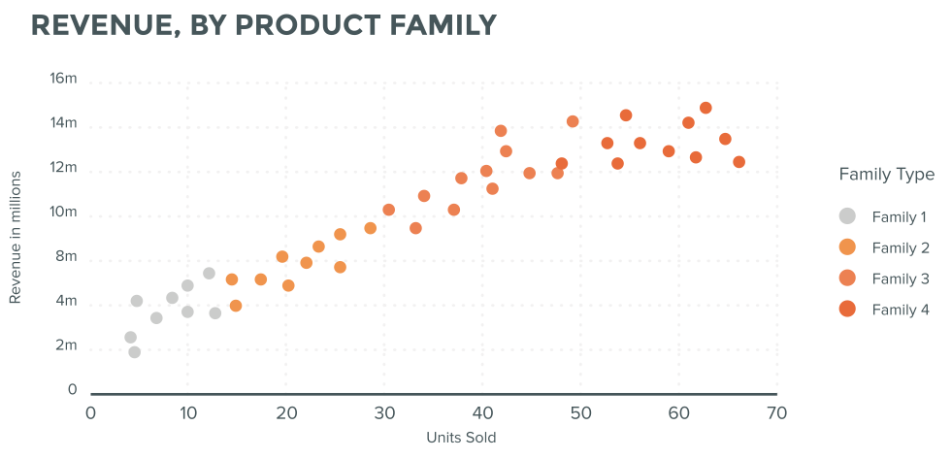
Data Analysis...
https://www.usda.dataanalystis.gov
LOGIN
MY PROFILE
CONTACT US
Graph
Comparison Table
CONTACT US
COMMUNITY STORIES | NEW VISUALIZATION | MY VISUALIZATIONS
?
1. Choose your data
3. Choose your variables and visualize results
1 of n datasets selected
Supported | Merged | To be supported
Scatter plots
Trend lines
Search datasets....
Variables to display
Name Data set sources
X Axis
Variable 1
Y Axis
Variable 4
Variable 6
Variable 10
X
Merged data set name Dataset name 1;
Description here can wrap Dataset name
up to 2 lines
Generate Visualization
Import
Merge Selected
Next step
2. Choose your insight
2 of n insights selected
-
I want to see the data organized
Comparison tables
Box plots
Scatter plots
Pie charts
Learn more
Learn more
Learn more
Learn more
X
Favored ‘post’ over ‘publish’ because it less formal; to scientists/academics, publish has a very serious meaning and could deter some from using it
-
I want to see trends in the data
X
Trend lines
Correlation heat maps
Learn more
Learn more
Next step
Post

Slide 19
Data Analysis...
https://www.usda.dataanalystis.gov
LOGIN
MY PROFILE
CONTACT US
Graph
Comparison Table
CONTACT US
COMMUNITY STORIES | NEW VISUALIZATION | MY VISUALIZATIONS
?
1. Choose your data
3. Choose your variables and visualize results
1 of n datasets selected
Supported | Merged | To be supported
Scatter plots
Trend lines
Search datasets....
Variables to display
Name Data set sources
X Axis
Variable 1
Y Axis
Variable 4
Variable 6
Variable 10
X
Merged data set name Dataset name 1;
Description here can wrap Dataset name
up to 2 lines
Post to this site
x
Posting makes this visualization available to other users to learn from.
Your username, <count of graphs> graph(s) for <tab name>, and the date will be automatically captured.
Please fill in the below fields to add context and value to your post.
Generate Visualization
Caption
Say something concise and informative here as a caption to your post
256 characters remaining
Details
Describe what you found, why it might be valuable to others, a lesson-learned, a question to pose, or anything that you think other users would find valuable to read
Import
Merge Selected
Next step
1024 characters remaining
2. Choose your insight
2 of n insights selected
Topic
- Select a relevant topic -
-
I want to see the data organized
Comparison tables
Box plots
Scatter plots
Pie charts
Learn more
Learn more
Learn more
Learn more
Submit posting
Cancel
X
-
I want to see trends in the data
X
Trend lines
Correlation heat maps
Learn more
Learn more
Next step
Post

Slide 20
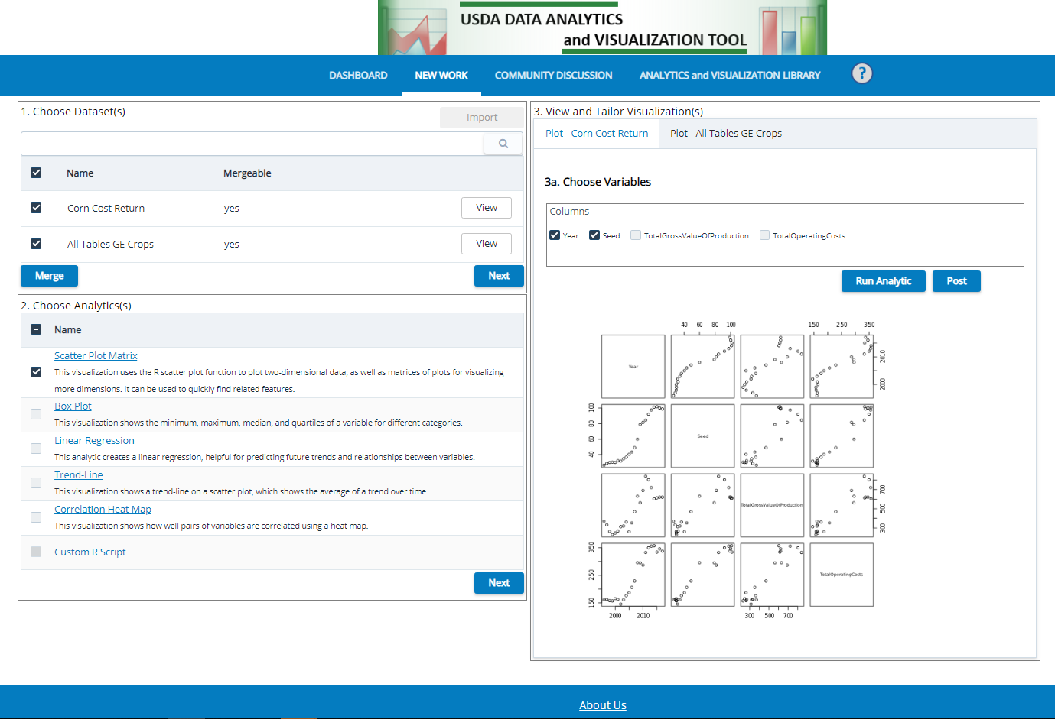
New Slide
(1)
Move this button to the right
Nice to have:
After a posting, provide this added text in the tab; number in parentheses goes away once the user clicks this tab
Toast message confirming posting; could be persisting text instead of toast; currently no feedback after clicking the post button that anything happened
Posted to Community Discussion!
Post

Slide 21
Backups

Slide 22
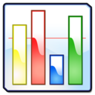
Data Analysis...
https://www.usda.dataanalystis.gov
DATA VISUALIZATION AND ANALYTICS
LOGIN
CONTACT US
My Saves
CONTACT US
USDA Data Set Analysis and Visualization Tool
?
Save
Reset
Choose Data
Search USDA data sets....
-
Results
Filters
USDA Topic (# of data sets)
Subtopic (# of data sets)
Type (# of data sets)
Subtype (# of data sets)
Reset
Apply >
+
Add Analytics
+
See Visualizations

Slide 23
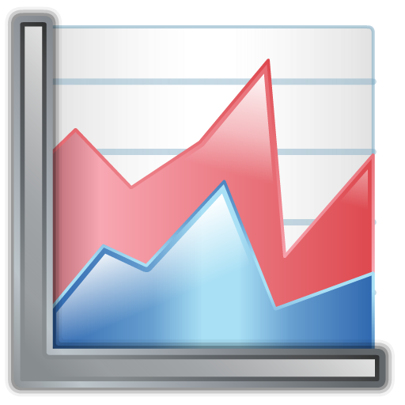





Data Analysis...
https://www.usda.dataanalystis.gov
USDA DATA ANALYTICS
and VISUALIZATION TOOL
LOGIN
MY PROFILE
CONTACT US
Graph
Comparison Table
CONTACT US
DASHBOARD | NEW WORK | SAVED WORK | ANALYTICS and VISUALIZATION LIBRARY
?
1. Choose available datasets
3. View and tailor visualizations
Import
Search datasets....
Filters
Analytic 1
3a. Choose variables
X
Data set name 1
Description
(description wrapped)
X
X Axis
Variable 1
Y Axis
Variable 4
Variable 6
Variable 10
X
Data set name 2
Description
(description wrapped)
Data set name 3
Description
(description wrapped)
3b. Visualize Analytic
Data set name 4
Description
(description wrapped)
2 of 4 datasets selected
Next
2. Choose analytics
Simple plot
X
Analytic 1
Description
Analytic 2
Description
1 of 3 analytics selected
Next

Slide 24

Data Analysis...
https://www.usda.dataanalystis.gov
USDA DATA ANALYTICS
and VISUALIZATION TOOL
LOGIN
MY PROFILE
CONTACT US
Graph
Comparison Table
CONTACT US
DASHBOARD | NEW WORK | SAVED WORK | ANALYTICS and VISUALIZATION LIBRARY
?
1. Choose available datasets
3. View and tailor visualizations
Import
Search datasets....
Filters
Analytic 1
Analytic 2
Data set name 1
Description
(description wrapped)
What content would they want to control for a table?
X
X
Data set name 2
Description
(description wrapped)
Data set name 3
Description
(description wrapped)
3b. Visualize Analytic
Data set name 4
Description
(description wrapped)
2 of 4 datasets selected
Next
2. Choose analytics
Simple plot
X
Analytic 1
Description
X
Analytic 2
Description
2 of 3 analytics selected
Next

